Slide 1
RESULTS AND NEXT STEPS
COMPANY RESULTS UP TO Q2 2023
J. DOE - CFO
09-01-2023

Slide 2

FINANCIAL & SALES
REVENUE AND PROFIT EVOLUTION

Slide 3
TOTAL REVENUE
YEAR TO YEAR EVOLUTION
6.97 M
GROSS PROFIT
3.90 M
10.95M
-36.37%
6.12M
-36.31%

Slide 4

STORES
DISTRIBUTION AND PERFORMANCE

Slide 5

DISTRIBUTION OF STORES
NUMBER OF STORES PER COUNTRY

Slide 6

RANKING PER PROFIT
GROSS PROFIT (IN THOUSANDS OF DOLLARS)

Slide 7

PRODUCTS
POPULAR ITEMS AND CATEGORIES

Slide 8




TOP CATEGORIES
PER PROFIT
PER QUANTITY PURCHASED
PER NUMBER OF CUSTOMERS
COMPUTERS
CELL PHONES
CELL PHONES
HOME APPLIANCES
COMPUTERS
COMPUTERS
CELL PHONES
MUSIC, MOVIES AND AUDIO BOOKS
MUSIC, MOVIES AND AUDIO BOOKS

Slide 9





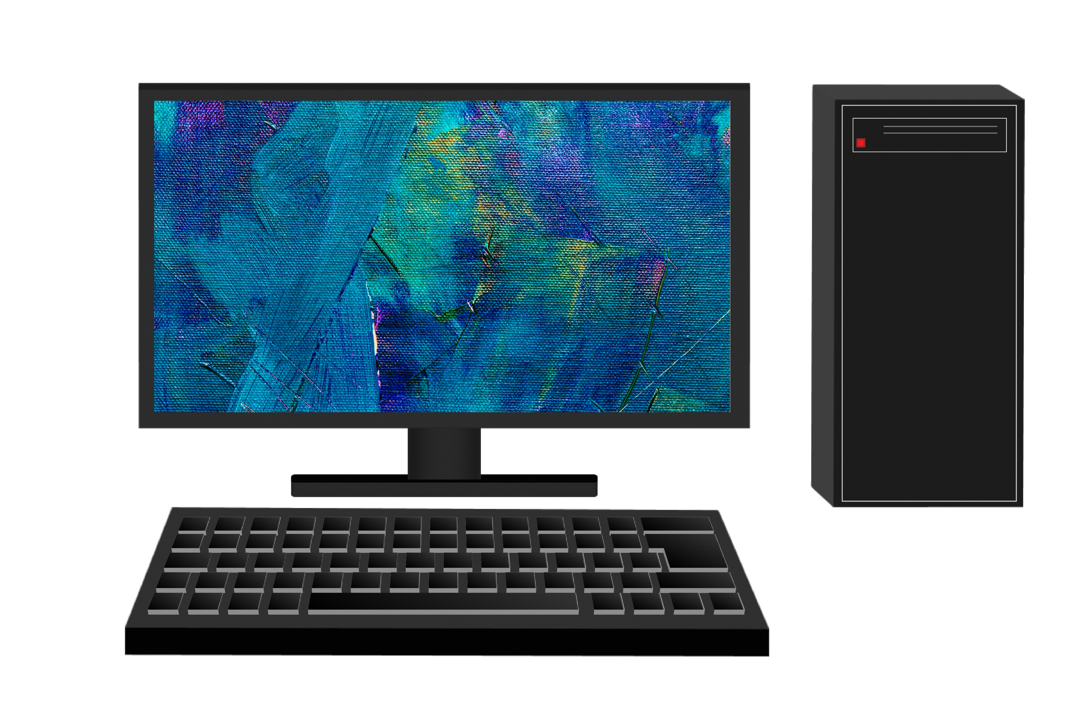


TOP PRODUCTS
PER PROFIT
PER QUANTITY PURCHASED
PER NUMBER OF CUSTOMERS
Adventure Works 52’’ LCD HDTV X590 Silver
SV DVD Recorder L230 Grey
SV DVD 14-Inch Player Portable L100 Black
Adventure Works 52’’ LCD HDTV X590 White
TomorrowStore DVD 7-Inch Player Portable E200 Silver
SV DVD Recorder L230 Grey
WWI Desktop PC2.33 X2330 Black
SV DVD Movies E100 Yellow
SV DVD Recorder L200 Black
Computers Music, Movies and Audio Books TV and Video

Slide 10

OUR CUSTOMERS
DEMOGRAPHICS AND HABITS

Slide 11
CUSTOMERS STATISTICS
TOTAL CUSTOMERS: 3164
WITH +1 PURCHASE: 87
BY GENDER
BY AGE
BY COUNTRY

Slide 12

KEY INSIGHTS
OUR STRENGHTS AND WEAKNESSES

Slide 13



REVENUE AND PROFIT EVOLUTION BY LOCATION OF STORES
REVENUE
GROSS PROFIT
REVENUE
GROSS PROFIT
5.52 M
3.08 M
1.45 M
820 K
+ REST OF COUNTRIES
3.20M
7.76M
-28.84%
1.79M
4.33M
-54.63%
-28.95%
-54.14%
Notes:
Key takeaways:
Our drop in revenue and gross profit has been far greater for USA and UK stores than for the online store and the rest of countries.
For USA and the UK, both measures decreased with no interruption through all year, reaching a year-to-year fall of more than 50%.

Slide 14
REVENUE AND PROFIT EVOLUTION BY PRODUCT CATEGORIES
AUDIO
GAMES AND TOYS
HOME APPLIANCES
REVENUE
GROSS PROFIT
CAMERAS AND CAMCORDERS
CELLPHONES
COMPUTERS
MUSIC, MOVIES AND AUDIO BOOKS
TV AND VIDEO
REVENUE
GROSS PROFIT
1.56 M
859 K
5.41 M
3.04 M
9.31M
1.65M
-5.35%
5.20M
-41.85%
920K
-6.63%
-41.56%
Notes:
Key takeaways:
All product categories showed a decrease in revenue and profit. For Audio, Games and Toys, and Home Appliances, the year-to-year decrease was milder, of 5-6%.
For the remaining categories, there was a much stronger drop, of more than 40%.

Slide 15
REVENUE AND PROFIT EVOLUTION FOR TOP PRODUCTS
REVENUE
GROSS PROFIT
275 K
178 K
Adventure Works 52’’ LCD HDTV X590 Silver
28.96%
213K
27.85%
Adventure Works 52’’ LCD HDTV X590 White
139K
WWI Desktop PC2.33 X2330 Black
Computers Music, Movies and Audio Books TV and Video
Notes:
Key takeaways:
Our three top products in terms of profit are also the ones that registered an increase in year-to-year revenue and profit.
For both measures, there was a significant growth, near to 30%.

Slide 16

CONCLUSIONS
OUR NEXT STEPS FOR Q3

Slide 17
WHAT SHOULD BE OUR NEXT STEPS FOR Q3?
Revert the negative tendency on profit. Design new marketing campaigns and customer attraction strategies directed to our weaker product categories and locations (USA and UK).
Improve our online store. Upgrade user experience and develop a greater internet presence, as it shows to be our main sales channel.
Invest on our top products. Increase marketing efforts in our top 3 products, which have shown significant growth in sales.
Work on customer loyalty. Improve our relationship with customers to increase the number of repeated purchases.

